Slide 1
Think NXT Program
SQL Server Database training – Session1
2023

Slide 2
Agenda
Introduction
Why we need a Database
DBMS Features and Types
Data Modelling
Installation of SQL Server
What is SQL Server?
SQL Server Architecture Explained: Named Pipes, Optimizer, Buffer Manager
SQL Server Database

Slide 3


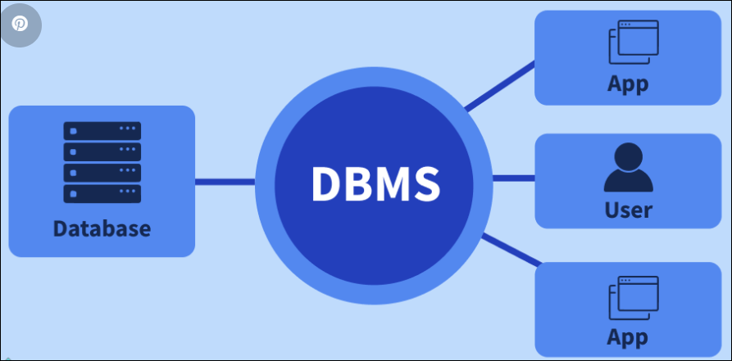
Why we need a Database
The purpose of a database is to assist in organizing the data coming in which improves its accessibility.
Manage large amount of data
Accurate
Using database software, you can improve the analysis of your data and get actionable insights to act upon without delays.
Easy to search data
Easy to update
DBMS software is used for storing, manipulating, and managing data, such as format, names of fields, and record and file structures in a database environment.
Data Integrity
Security of data
The purpose of a database is to store different data in several ways.
Textual data
Numerical data
Binary data
Data and time
DBMS softwares: MySQL, Microsoft SQL Server, Microsoft Access DBMS, Oracle, IBM DB2, and FoxPro

Slide 4
DBMS Features and Types
Low Repetition and Redundancy
In a database, the chances of data duplication are quite high as several users use one database. A DBMS reduces data repetition and redundancy by creating a single data repository that can be accessed by multiple users, even allowing easy data mapping while performing ETL.
Easy Maintenance of Large Databases
Most organizational data is stored in large databases. A DBMS helps maintain these databases by enforcing user-defined validation and integrity constraints, such as user-based access.
Enhanced Security
When handling large amounts of data, security becomes the top-most concern for all businesses. A database management software doesn’t allow full access to anyone except the database administrator or the departmental head. Only they can modify the database and control user access, making the database more secure. All other users are restricted, depending on their access level.
Improved File Consistency
By implementing a database management system, organizations can create a standardized way to use files and ensure consistency of data with other systems and applications. Manipulating and streamlining advanced data management systems is essential. The application of an advanced database system allows using the same rules to all the data throughout the organization.
Multi-User Environment Support
A database management software features and supports a multi-user environment, allowing several users to access and work on data concurrently

Slide 5
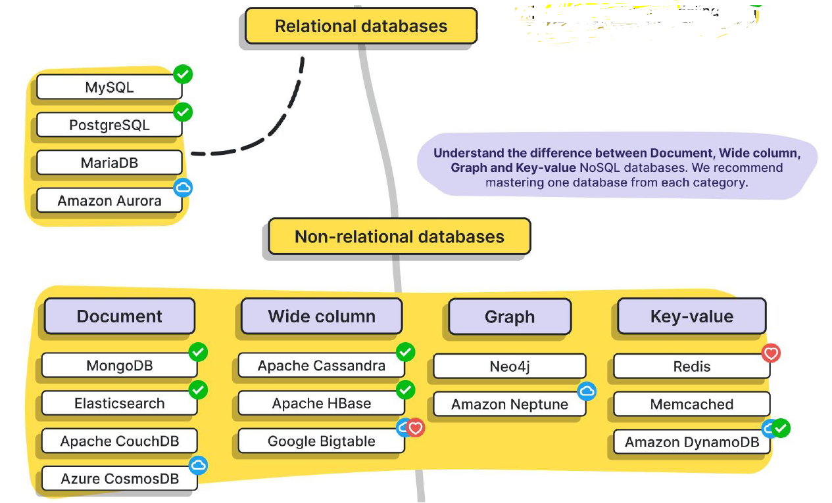
Types of Databases

Slide 6
Data Modeling
A data model is an abstraction of some aspect of the real world (system)
Why a data model?
Helps to visualize the business
A model is a means of communication
Models help elicit and document requirements
Models reduce the cost of change
Model is the essence of DW architecture based on which DW will be implemented

Slide 7
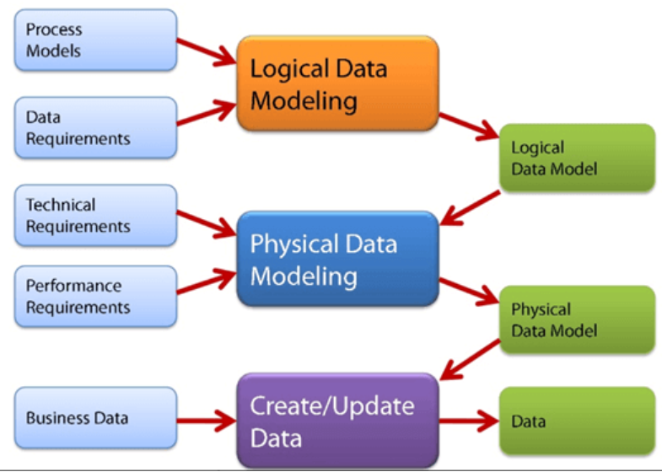
Types of Data Models
Conceptual Data Model: This Data Model defines WHAT the system contains. This model is typically created by Business stakeholders and Data Architects. The purpose is to organize, scope and define business concepts and rules.
Logical Data Model: Defines HOW the system should be implemented regardless of the DBMS. This model is typically created by Data Architects and Business Analysts. The purpose is to developed technical map of rules and data structures.
Physical Data Model: This Data Model describes HOW the system will be implemented using a specific DBMS system. This model is typically created by DBA and developers. The purpose is actual implementation of the database.

Slide 8
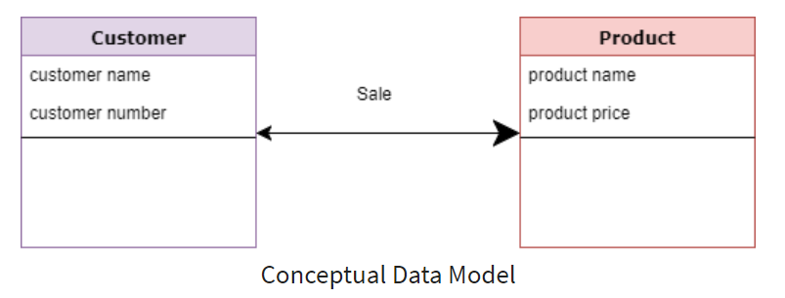
Conceptual Data Model
A Conceptual Data Model is an organized view of database concepts and their relationships.
Purpose: To establish entities, their attributes, and relationships.
In this data modeling level, there is hardly any detail available on the actual database structure. Business stakeholders and data architects typically create a conceptual data model.
3 basic tenants of Conceptual Data Model are
Entity: A real-world thing
Attribute: Characteristics or properties of an entity
Relationship: Dependency or association between two entities
Data model example:
Customer and Product are two entities. Customer number and name are attributes of the Customer entity
Product name and price are attributes of product entity
Sale is the relationship between the customer and product
Characteristics of a conceptual data model
Offers Organization-wide coverage of the business concepts.
This type of Data Models are designed and developed for a business audience.

Slide 9
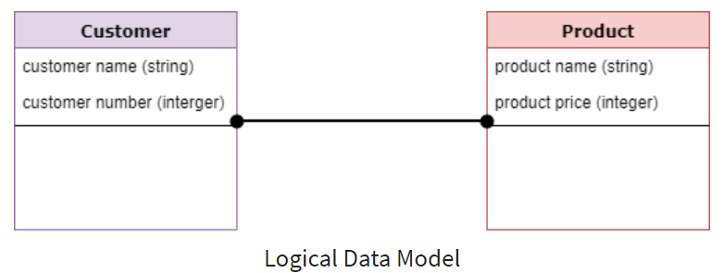
Logical Data Model
The Logical Data Model is used to define the structure of data elements and to set relationships between them. The logical data model adds further information to the conceptual data model elements.
The advantage of using a Logical data model is to provide a foundation to form the base for the Physical model. However, the modeling structure remains generic.
At this Data Modeling level, no primary or secondary key is defined. At this Data modeling level, you need to verify and adjust the connector details that were set earlier for relationships.
Characteristics of a Logical data model
Describes data needs for a single project but could integrate with other logical data models based on the scope
Designed and developed independently from the DBMS.
Data attributes will have datatypes with exact precisions and length.
Normalization processes to the model is applied typically till 3NF.

Slide 10
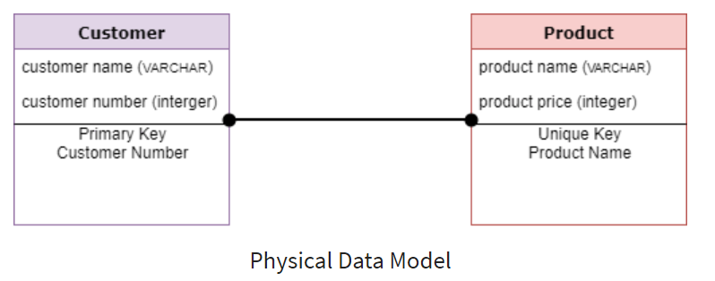
Physical Data Model
A Physical Data Model describes a database-specific implementation of the data model.
It offers database abstraction and helps generate the schema. This is because of the richness of meta-data offered by a Physical Data Model.
The physical data model also helps in visualizing database structure by replicating database column keys, constraints, indexes, triggers, and other RDBMS features.
Characteristics of a physical data model:
The physical data model describes data need for a single project or application
Data Model contains relationships between tables that which addresses cardinality and nullability of the relationships.
Developed for a specific version of a DBMS, location, data storage or technology to be used in the project.
Columns should have exact datatypes, lengths assigned and default values.
Primary and Foreign keys, views, indexes, access profiles, and authorizations, etc. are defined.

Slide 11
Conclusion – Data Model
Data modeling is the process of developing data model for the data to be stored in a Database.
Data Models ensure consistency in naming conventions, default values, semantics, security while ensuring quality of data.
Data Model structure helps to define the relational tables, primary and foreign keys and stored procedures.
There are three types of conceptual, logical, and physical.
The main aim of conceptual model is to establish the entities, their attributes, and their relationships.
Logical data model defines the structure of the data elements and set the relationships between them.
A Physical Data Model describes the database specific implementation of the data model.
The main goal of a designing data model is to make certain that data objects offered by the functional team are represented accurately.
The biggest drawback is that even smaller change made in structure require modification in the entire application.

Slide 12
Installation and Setup
Step-1 : SQL Server Express edition
https://www.microsoft.com/en-us/sql-server/sql-server-downloads
Step-2: Installation steps
https://www.sqlshack.com/how-to-install-sql-server-express-edition/
Step-3: SQL Management Studio
https://docs.microsoft.com/en-us/sql/ssms/download-sql-server-management-studio-ssms?view=sql-server-ver15

Slide 13


SQL Server Database
What is Database?
A database is a collection of objects such as tables,
views, stored procedures, triggers, functions, etc.
Consider a with a few examples in real life:
We have Bookcase where Books resides,
We have homes where we live,
We have parking lots where vehicles are parked
SQL Categorization
DDL (Data Definition Language) create, alter, drop, truncate
DML (Data Manipulation Language) insert, update and delete
Select - Select command is used to retrieve data from database.
DCL (Data Control Language) Grant, invoke
Data Types of SQL Server
There are many data types available in SQL Server and some of these are as follows
Numeric int(4 bytes), bigint (8 bytes) , smallint (2 bytes) and tinyint (1 byte)
Floating Point Numeric Float(size depends on value) , Real (4 bytes)
Character String Char, Varchar, Text

Slide 14
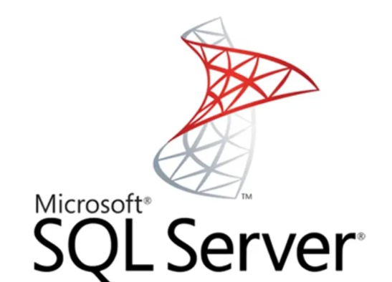
What is SQL Server?
SQL SERVER is a relational database management system (RDBMS) developed by Microsoft. It is primarily designed and developed to compete with MySQL and Oracle database.
SQL Server supports ANSI SQL, which is the standard SQL (Structured Query Language) language. However, SQL Server comes with its own implementation of the SQL language, T-SQL (Transact-SQL).
T-SQL is a Microsoft propriety Language known as Transact-SQL.
It provides further capabilities of declaring variable, exception handling, stored procedure, etc.
SQL Server Management Studio (SSMS) is the main interface tool for SQL Server, and it supports both 32-bit and 64-bit environments.

Slide 15
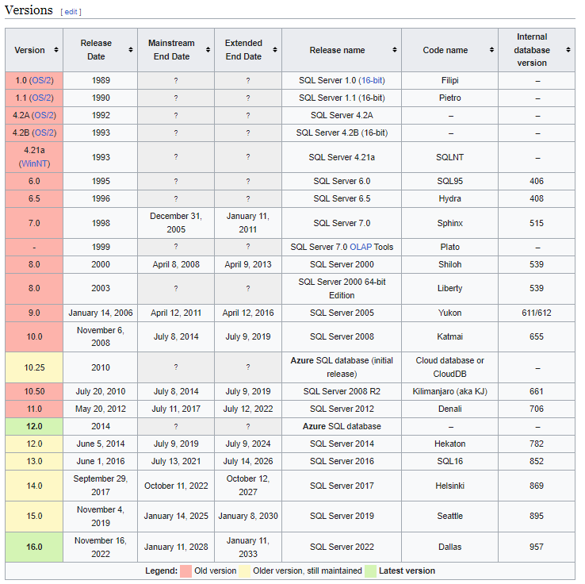
SQL Server Versions

Slide 16
SQL Server Editions
Free editions
Express | Express edition is a free lightweight/lite edition of SQL Server with some limitations, that can be used in production environment. Main limitations: • Limited to lesser of 1 physical CPU or 4 cores. • No single database (.MDF file) can be over 10 GB. | Download SQL2022 Express Edition Download SQL2019 Express Edition Download SQL2017 Express Edition Download SQL2016 Express Edition
Developer | Developer edition is a fully-functional Enterprise Edition of SQL Server, licensed for use as a development and test database in a non-production environment. | Download SQL2022 Developer Edition Download SQL2019 Developer Edition Download SQL2017 Developer Edition
Evaluation | Evaluation edition is a fully-functional trial Enterprise Edition of SQL Server but is limited to 180 days, after which the tools will continue to run, but the server services will stop | Download SQL2022 Evaluation Edition Download SQL2019 Evaluation Edition Download SQL2017 Evaluation Edition Download SQL2016 Evaluation Edition

Slide 17
SQL Server Editions
Paid editions
Enterprise | Enterprise edition is the top-end edition with a full feature set.
Enterprise Core | Enterprise edition with the Core-based Licensing. The plain Enterprise one is limited to just 20 CPU cores.
Standard | Standard edition has less features than Enterprise, when there is no requirement of advanced features.
Paid editions
Web | Web edition is a low total-cost-of-ownership option for Web hosters.
Business Intelligence | Business Intelligence edition includes the Standard Edition capabilities and Business Intelligence tools.
Analytics Platform System (APS) | Formerly Parallel Data Warehouse (PDW). A massively parallel processing (MPP) SQL Server appliance optimized for large-scale data warehousing such as hundreds of terabytes.
Big Data Clusters (BDC) | Starting with SQL Server 2019, SQL Server Big Data Clusters allow you to deploy scalable clusters of SQL Server, Spark, and HDFS (Hadoop Distributed File System) containers running on Kubernetes.
LocalDB | SQL Server Express LocalDB is a lightweight version of Express that has all of its programmability features, runs in user mode and has a fast, zero-configuration installation and a short list of prerequisites.

Slide 18
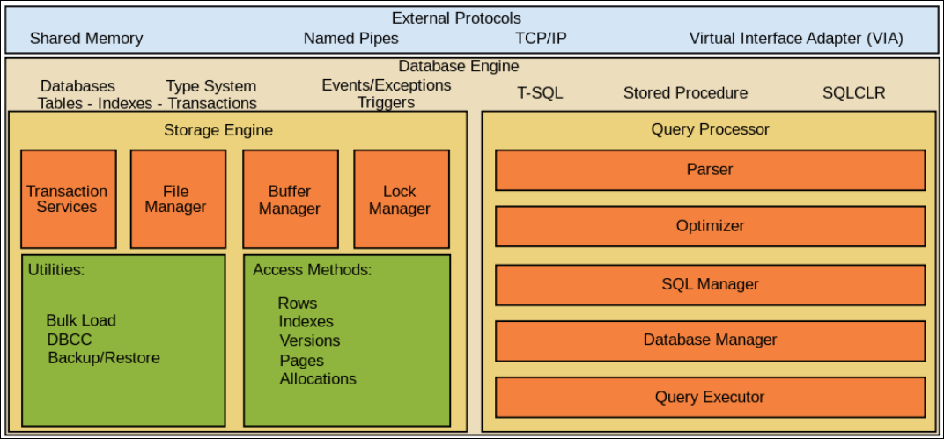
SQL Server Architecture Explained: Named Pipes, Optimizer, Buffer Manager
SQL Server is a client-server architecture. MS SQL Server process starts with the client application sending a request. The SQL Server accepts, processes and replies to the request with processed data. Let's discuss in detail the entire architecture shown below:
As the diagram depicts there are three major components in SQL Server Architecture:
Protocol Layer 2.Relational Engine OR Query Processor 3. Storage Engine

Slide 19
SQL Server Editions
SQL Server Editions
SQL Server has four primary editions that have different bundled services and tools. Two editions are available free of charge:
SQL Server Developer edition for use in database development and testing.
SQL Server Expression for small databases with the size up to 10 GB of disk storage capacity.
For larger and more critical applications, SQL Server offers the Enterprise edition that includes all SQL server’s features.
SQL Server Standard Edition has partial feature sets of the Enterprise Edition and limits on the Server regarding the numbers of processor core and memory that can be configured.
For the detailed information on the SQL Editions, check it out the available Server Server 2017 Editions.

Slide 20
SQL Server Editions
SQL Server edition | Definition
Enterprise (premium offering) | Comprehensive high-end datacenter capabilities with blazing-fast performance unlimited virtualization¹, and end-to-end business intelligence - enabling high service levels for mission-critical workloads and end-user access to data insights.
Standard | Basic data management and business intelligence database for departments and small organizations to run their applications and supports common development tools for on-premises and cloud - enabling effective database management with minimal IT resources.
Developer | Provides developers build any kind of application on top of SQL Server. It includes all the functionality of Enterprise edition but is licensed for use as a development and test system, not as a production server. SQL Server Developer is an ideal choice for people who build and test applications.
Express editions | Entry-level, free database and is ideal for learning and building desktop and small server data-driven applications. It is the best choice for independent software vendors, developers, and hobbyists building client applications. SQL Server Express LocalDB is a lightweight version of Express that has all its programmability features, runs in user mode and has a fast, zero-configuration installation and a short list of prerequisites.

Slide 21
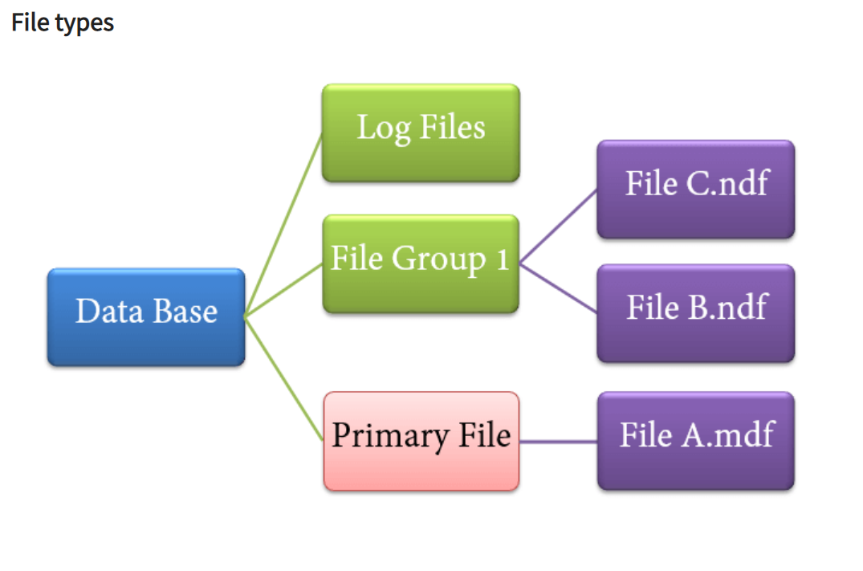
SQL Server Database filetypes
Primary file
Every database contains one Primary file.
This store all important data related to tables, views, Triggers, etc.
Extension is .mdf usually but can be of any extension.
Secondary file
Database may or may not contains multiple Secondary files.
This is optional and contain user-specific data.
Extension is .ndf usually but can be of any extension.
Log file
Also known as Write ahead logs.
Extension is .ldf
Used for Transaction Management.
This is used to recover from any unwanted instances. Perform important task of Rollback to uncommitted transactions.

Slide 22
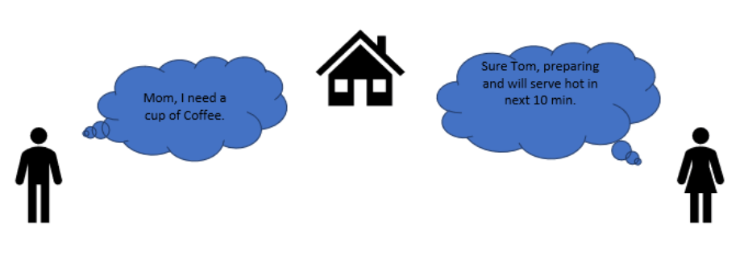
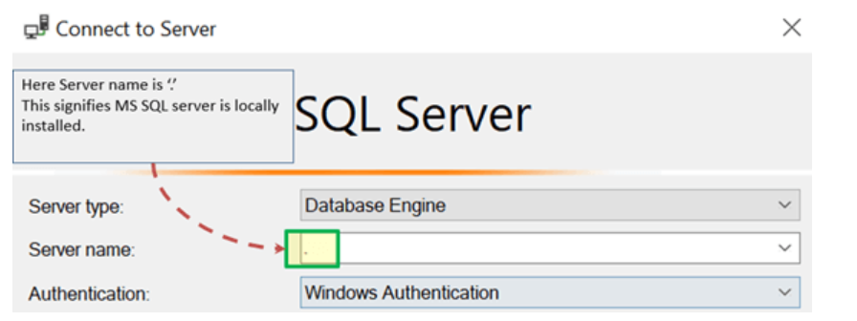
Shared Memory
MOM and TOM - Here Tom and his Mom, were at the same logical place, i.e. at their home.
Tom was able to ask for Coffee and Mom was able it serve it hot.
MS SQL SERVER - Here MS SQL server provides SHARED MEMORY PROTOCOL. Here CLIENT and MS SQL server run on the same machine. Both can communicate via Shared Memory protocol.
Analogy: Lets map entities in the above two scenarios. We can easily map Tom to Client, Mom to SQL server, Home to Machine, and Verbal Communication to Shared Memory Protocol.
From the desk of configuration and installation:

Slide 23
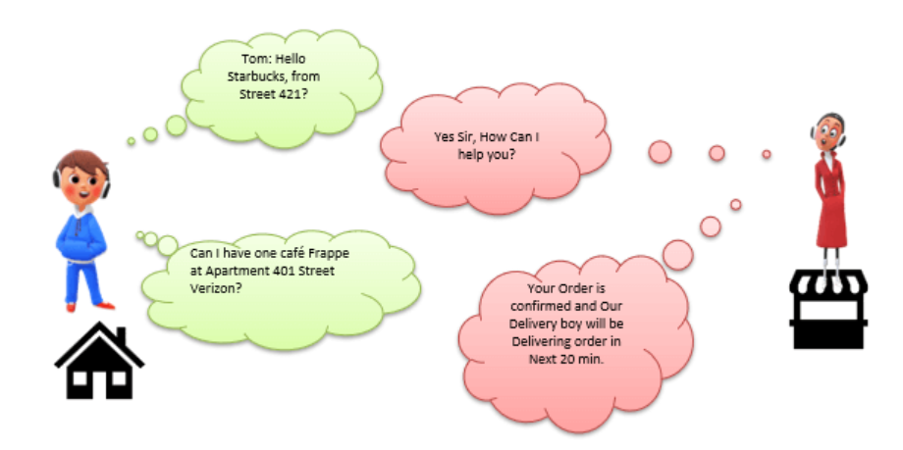
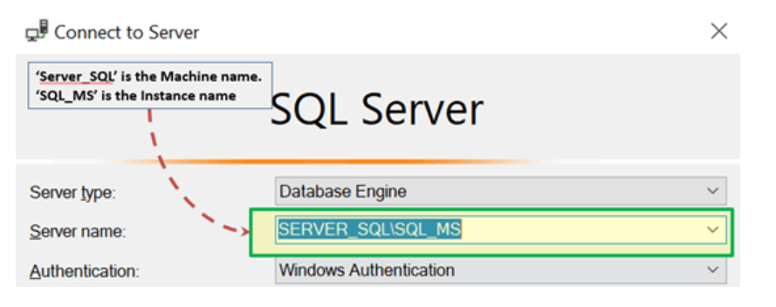
TCP/IP
Now consider in the evening, Tom is in the party mood. He wants a Coffee ordered from a well-known Coffee Shop.
The Coffee shop is located 10 km away from his home.
Here Tom and Starbuck are in different physical location. Tom at home and Starbucks at the busy marketplace. They're communicating via Cellular network. Similarly, MS SQL SERVER provides the capability to interact via TCP/IP protocol, where CLIENT and MS SQL Server are remote to each other and installed on a separate machine.
Analogy: Lets map entities in the above two scenarios. We can easily map Tom to Client, Starbuck to SQL server, the Home/Market place to Remote location and finally Cellular network to TCP/IP protocol.
Notes from the desk of Configuration/installation:
In SQL Management Studio - For Connection via TCP\IP, "Server Name" Option has to be "Machine\Instance of the server."
SQL server uses port 1433 in TCP/IP.

Slide 24

Named Pipes
Here Tom and his Neighbor, Sierra, are in same physical location, being each other's neighbor.
They're communicating via Intra network. Similarly, MS SQL SERVER provides the capability to interact via the Named Pipe protocol. Here the CLIENT and MS SQL SERVER are in connection via LAN.
Analogy: Lets map entities in the above two scenarios. We can easily map Tom to Client, Sierra to SQL server, Neighbor to LAN and finally Intra network to Named Pipe Protocol.
Notes from the desk of Configuration/installation:
For Connection via Named Pipe. This option is disabled by default and needs to be enabled by the SQL Configuration Manager.

Slide 25
Practice
Hands on exercise

